Slide 1




Education Data Analysis Source: https://www.data.gov.in/resource/district-wise-number-schoolsstudent-enrollment-and-pass-percentage-class-x-and-xii-delhi Dataset: EducationDataset Email: bslpravallika1804@gmail.com Phone : 8978395497 LinkedIn : https://www.linkedin.com/in/pravallika-b-s-l-111a75267
Education Data Analysis Using PySpark
B.S.L.Pravallika 2211CS010038 S2-06

Slide 2
Introduction
This presentation provides a comprehensive analysis of the District Education dataset using PySpark, covering:
Dataset Structure and Characteristics
Nine Core Analytics Operations
Three Data Visualizations
Key Observations and Insights
Dataset Observations
Conclusion

Slide 3
Initial Analysis of the Dataset
Dataset Structure & Uniqueness
Data covers district-level education statistics across multiple zones.
Columns include: District, No. of Schools, No. of Students (Boys/Girls/Total), Pass %, Quality Index.
Represents both primary and secondary education levels (Class X & XII).
Data is clean and structured, with minor formatting inconsistencies (commas, spacing).
Provides a comprehensive view of educational performance by district.

Slide 4
Nine Core Analytics
1. Data Cleaning & Preparation:
Removed commas and converted numeric columns.
Standardized column names for consistency.
Dropped missing/null entries.
2. Summary Statistics:
Computed total schools and students per district.
Derived averages and totals across education levels.
Verified dataset consistency.

Slide 5
Nine Core Analytics
3. District-Level Comparison:
Ranked districts by total schools.
Identified top and bottom performers.
Visualized school distribution (bar chart).
4. Student Demographics:
Calculated total boys vs girls per district.
Highlighted gender gap regions.
Visualized as grouped bar chart.

Slide 6
Nine Core Analytics
5. Performance Analysis (Class X)*:
Computed pass percentages per district.
Sorted top 3 and bottom 3 performing districts.
Visualized comparison chart.
6. Performance Analysis (Class XII):
Similar pass percentage and ranking by district.
Compared trends between Class X and XII.
Analyzed improvement or decline rates.

Slide 7
Nine Core Analytics
7. Girls Retention Rate (X → XII):
Calculated % of girls continuing to Class XII.
Ranked districts by retention.
Highlighted education continuity challenges.
8. Gender-Based Performance:
Compared pass % of boys vs girls (X & XII).
Derived gender success ratios.
Identified performance parity/differences.

Slide 8
Nine Core Analytics
9. Export & Reporting:
Filtered low girl-enrollment districts (<5000).
Saved results as CSV (Spark + Pandas fallback).
Prepared analytics summary for reporting.

Slide 9
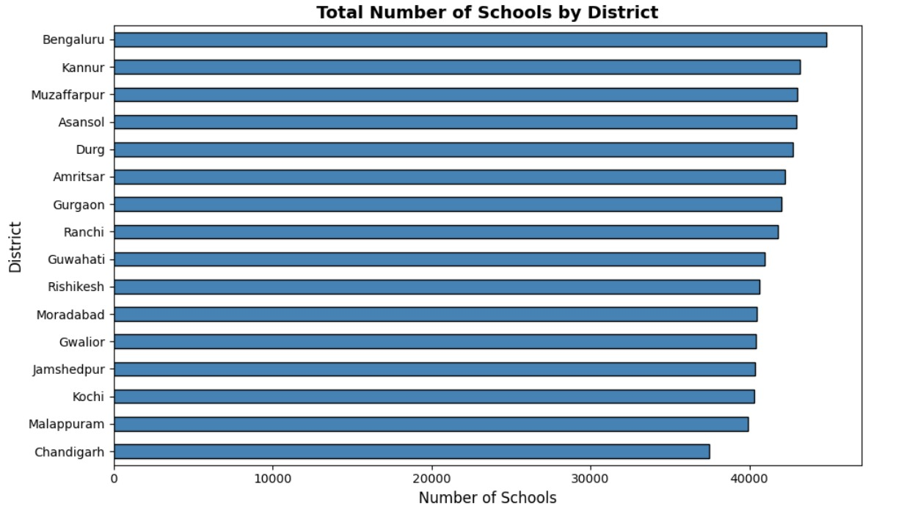
Six Visualizations
Total Schools by District
→ Bar Chart — compares number of schools across districts.

Slide 10
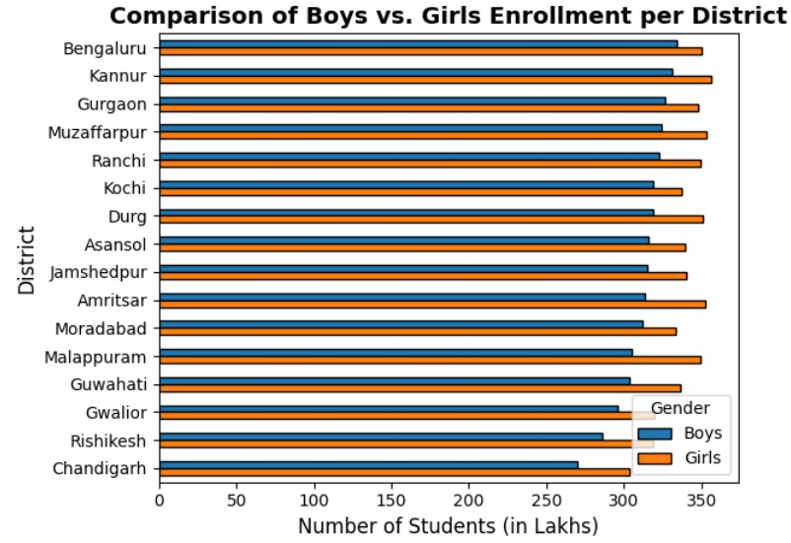
Six Visualizations
Boys vs Girls Enrollment
→ Grouped Bar Chart — shows number of boys and girls per district.

Slide 11
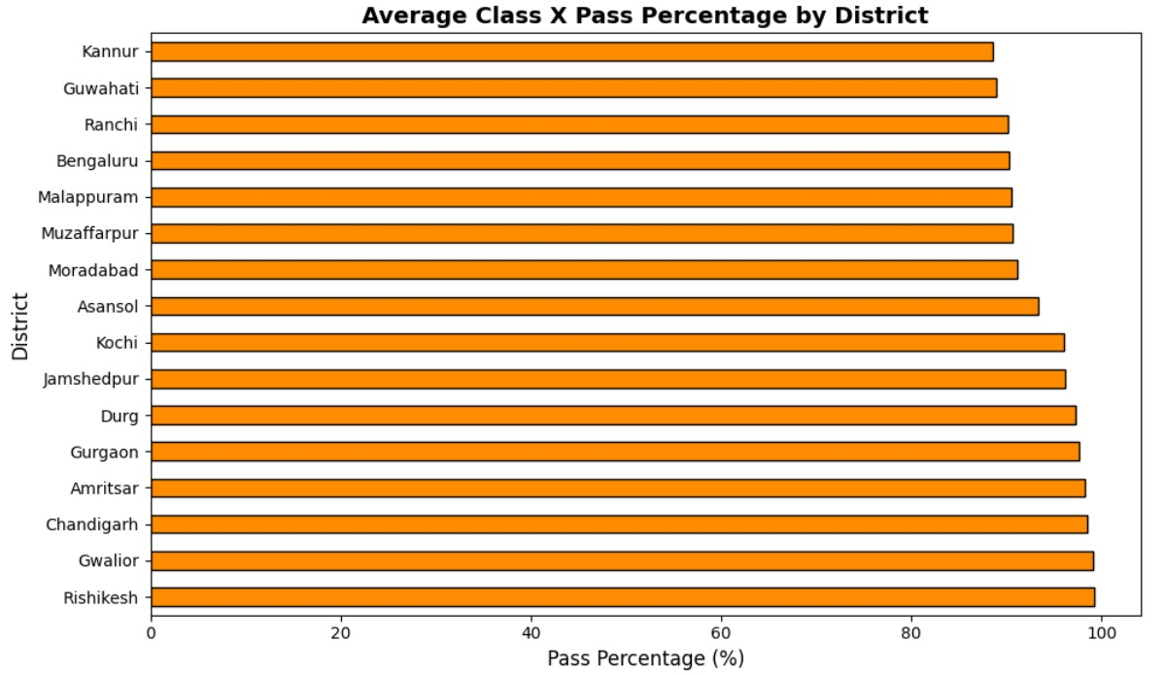
Six Visualizations
Class X Pass Percentage
→ Bar Chart — displays pass percentage for each district.

Slide 12
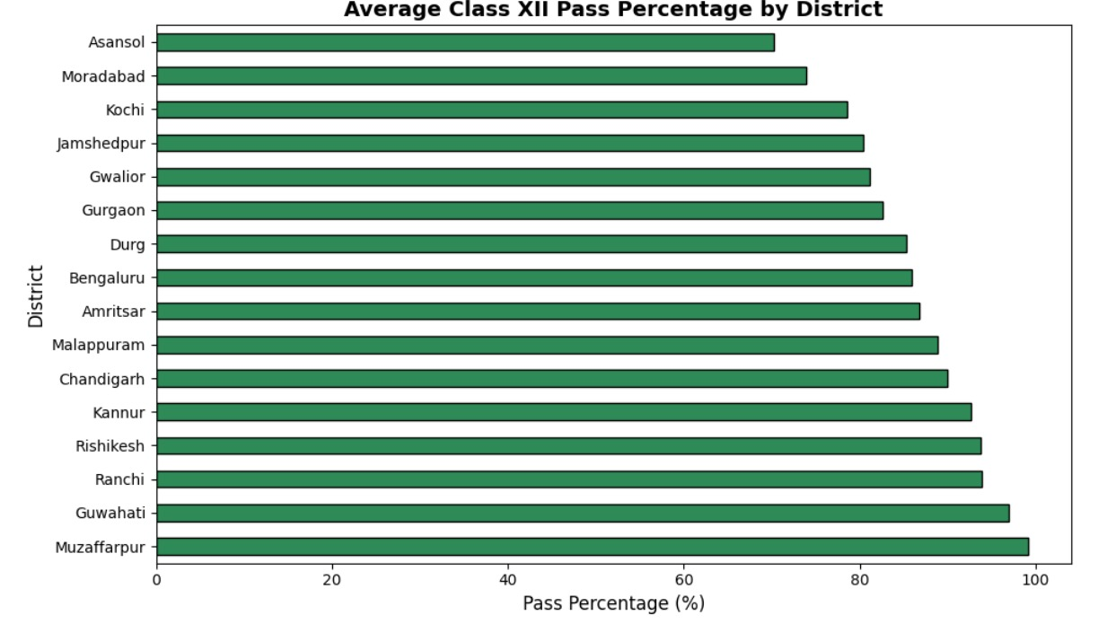
Six Visualizations
Class XII Pass Percentage
→ Bar Chart — shows pass percentage for each district (Top & Bottom 3 highlighted).

Slide 13
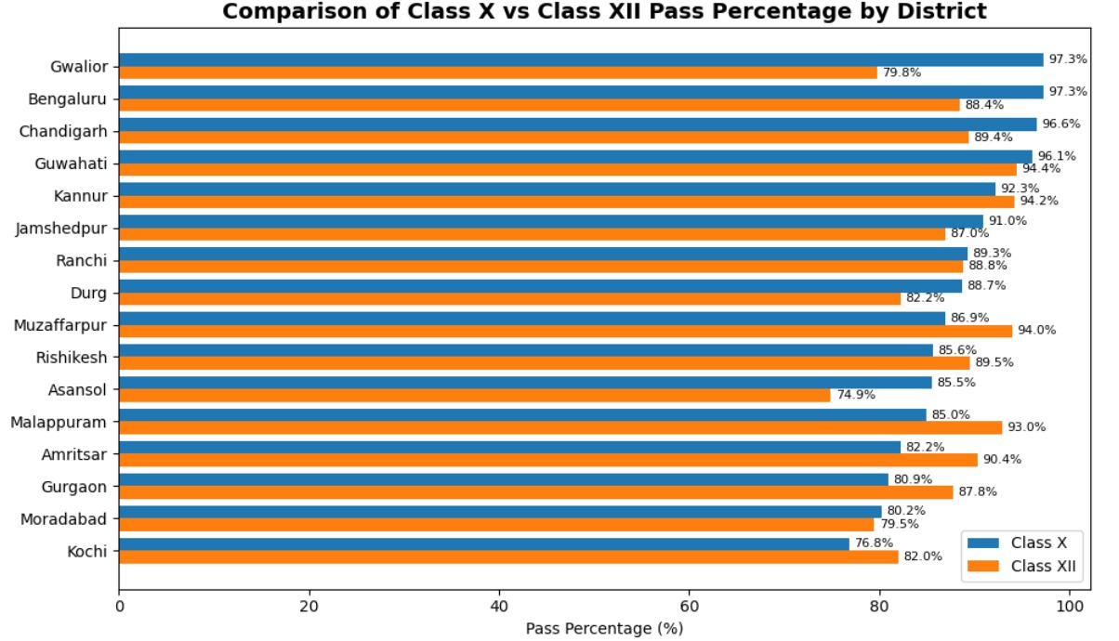
Six Visualizations
Class X vs Class XII Pass Percentage
→ Horizontal Bar Chart — compares pass percentage of Class X to XII by district.

Slide 14
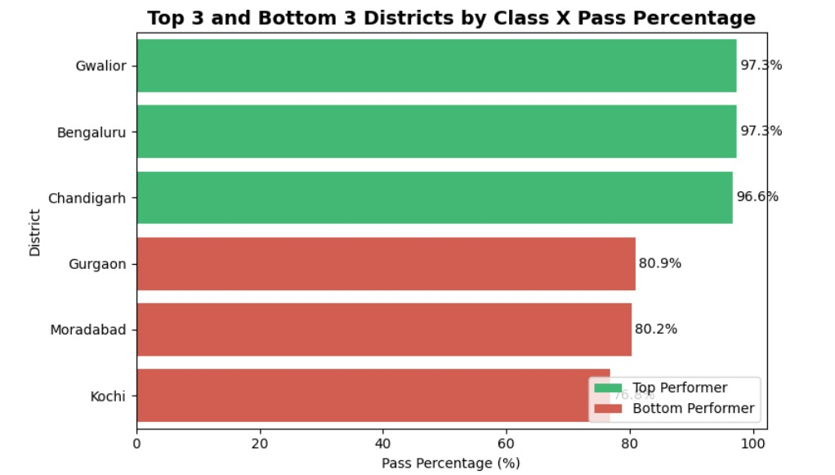
Six Visualizations
Districts with Most vs Least X Pass Percentage
→ Bar Chart — compares top 3 and bottom 3 X Pass Percentage.

Slide 15
Key Observations and Insights
Driver Performance
Hamilton, Vettel, and Verstappen lead in total points and wins.
Podium finishes reveal consistency beyond outright victories.
Constructor Dominance
Ferrari and Mercedes dominate across eras.
Red Bull’s sharp rise is evident in the hybrid era.
Race Dynamics
Strong correlation between starting grid and finishing position.
DNFs heavily impact outcomes; reliability is critical.
Season & Geography
2023–2024 highlight Verstappen’s continued dominance.
UK, Italy, and USA host the largest share of races.
Statistical Insights
Negative correlation: higher grid start → more points.
Laps completed weakly correlate with points (finishing ≠ success).

Slide 16
Dataset Observation
School Distribution: Large variation in total schools — some districts highly equipped, others lagging.
Gender Enrollment: Boys slightly outnumber girls; several districts show near parity.
Class X Results: Top districts >90% pass rate; weaker ones indicate need for targeted support.
Girls’ Retention: Noticeable drop from Class X → XII; social and economic factors likely causes.
Regional Gaps: Few districts dominate in girl enrollment; others need focused gender initiatives.

Slide 17
Conclusion
The dataset reveals imbalances in school infrastructure and student enrollment across districts.
Gender participation is improving, but retention of girls beyond Class X remains a concern.
Academic performance varies widely, suggesting unequal access to quality education.
Insights highlight the need for data-driven policy decisions to enhance equity and outcomes.
Future focus: improving retention, boosting performance, and strengthening underperforming districts.

